Slide 1
Integrated analysis of lncRNA-miRNA-mRNA ceRNA network in human renal cell carcinoma
R. Atallah
Department of Computer Science & Mathematics, School of Arts & Sciences, Lebanese American University, Byblos, email: roberto.atallah@lau.edu

Slide 2

1. Introduction
Renal cell carcinoma (RCC) accounts for approximately 90% of all kidney cancer cases and has a low 5-year survival rate for advanced stage disease.
1
Non-coding RNAs (ncRNAs), especially long non-coding RNAs (lncRNAs), have emerged as important regulators of gene expression in various cancers, including RCC.
2
Competing endogenous RNA (ceRNA) networks involving lncRNAs, microRNAs (miRNAs), and messenger RNAs (mRNAs) have been proposed as a novel regulatory mechanism.
3
Dysregulation of ceRNA networks has been implicated in various diseases, including cancer.
4
This study aimed to comprehensively analyze the lncRNA-miRNA-mRNA ceRNA network in human RCC and identify potential therapeutic targets for this deadly disease.
5

Slide 3


1. Introduction
Gene Expression Omnibus (GEO) database was used to obtain RCC-related lncRNA, mRNA, and miRNA expression data.
Differentially expressed mRNAs, miRNAs, and lncRNAs were identified and used for functional enrichment analysis to identify key biological pathways and processes involved in RCC.
Cytoscape was used to construct a lncRNA-miRNA-mRNA network and a protein-protein interaction (PPI) network to later identify key genes differentially expressed in RCC.
The findings of this study provide insights into the molecular mechanisms underlying RCC and potential therapeutic targets for this deadly disease.

Slide 4
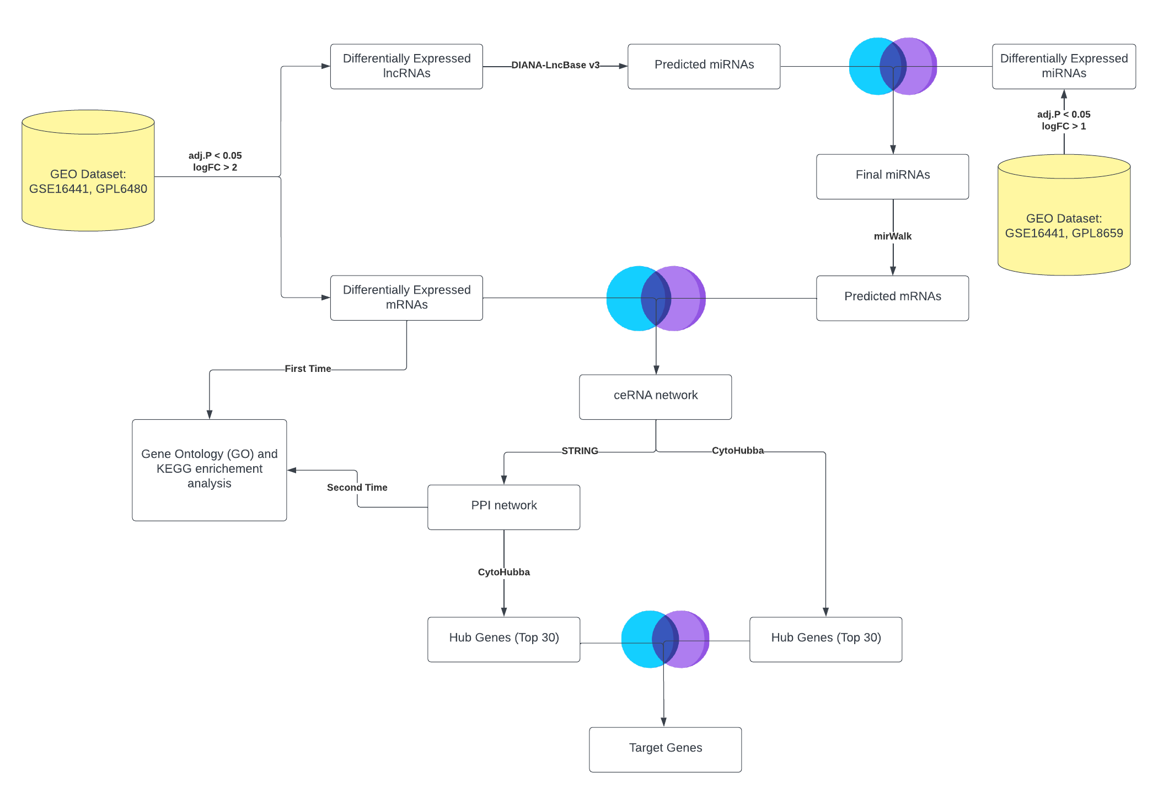
Flow chart of the steps (methodolody) used in this study

Slide 5

2. Materials & Methods 2.1 Microarray Data
The dataset GSE16441 from the GEO database of NCBI was chosen for this study.
The screening criteria for the species type were set as "Homo sapiens", and keywords such as "Renal Cell Carcinoma", "miRNA", "mRNA" were used to search for relevant datasets.
GSE16441 was included in the study, which is divided into two platforms.
Platform GPL6480 contains total RNA expression data from 17 RCC tumor samples and 17 corresponding non-tumor samples, which was used to find differentially expressed lncRNA and mRNA.
Platform GPL8659 contains miRNA expression data from 17 RCC tumors and 17 corresponding non-tumor samples, which was used to find differentially expressed microRNAs.

Slide 6
2. Materials & Methods 2.2. Differentially Expressed Genes, miRNA and lncRNA (DEGs, DEMs and DELs) analysis
DEGs were analyzed using the R package "Linear Models for Microarray Data (limma)" and "GEOquery" package was used to retrieve data from GEO database
Data was already normalized and log2 transformed, so no further normalization was performed
For GPL6480 platform (total RNA), log Foldchange > 2 and adjust. P < 0.05 were used to select DEGs and DELs
For GPL8659 platform (micro-RNA), log Foldchange > 1 and adjust. P < 0.05 were used to select DEMs
Volcano maps of DELs, DEMs and DEGs were drawn using R software
This data will be used for constructing ceRNA network and protein interaction network

Slide 7






2. Materials & Methods 2.3. Prediction of miRNA-mRNA and lncRNA-miRNA pairs & Establishment of the ceRNA network of lncRNA-miRNA-mRNA
DIANA-LncBase v3 was used to retrieve miRNA-lncRNA interactions with high confidence level.
Predicted miRNAs were intersected with DEMs to find miRNA-mRNA interactions.
Initially, to find mRNA targets of miRNA, the approach used in (Zhang et. al, 2021) was tried, but only 17 miRNA-mRNA interactions were found after intersecting with DEGs.
Hence, mirWalk database was used (approach used by many other similar papers like (Zhu. Et. Al. 2023)) to find predicted miRNA binding sites (mRNA) with high confidence. This approach was used in
Predicted target genes were intersected with DEGs to find final differentially expressed mRNAs.
The final ceRNA network was visualized using cytoscape.

Slide 8

2. Materials & Methods 2.4 PPI network analysis and key gene identification
Cytoscape software was used for ceRNA & PPI network analysis
The Search Tool for the Retrieval of Interacting Genes/Proteins (STRING) was used to retrieve protein-protein interactions (PPI) between the 208 DEGs found earlier
CytoHubba plugin in cytoscape was used to identify the hub genes (top 30) in the ceRNA network and PPI network
Key genes were identified by taking the intersection of hub genes in the ceRNA network and hub genes of the PPI network
These key genes will be used for follow-up analysis

Slide 9
2 Materials & Methods 2.5 Gene Ontology & Pathway Analysis
DAVID database was used to perform functional interpretation of DEGs
Gene Ontology (GO) was performed to identify the biological process, cellular component, and molecular function hierarchies.
Kyoto Encyclopedia of Genes and Genomes (KEGG) pathway analysis was performed to map genes to KEGG pathways.
GO and KEGG pathway analyses were performed twice, first using the differentially expressed genes from the GEO dataset and second using the genes involved in the PPI network constructed after performing the intersection with predicted mRNAs.
A P value of <0.05 was set as the cut-off criterion for the significance of the GO and pathway term enrichment in the DEGs.
All analyses were performed using an R script.

Slide 10
3 Results 3.1 Differentially Expression Analysis
880 differentially expressed mRNAs: 213 upregulated, 667 downregulated in total RNA samples
6 differentially expressed lncRNAs: 5 downregulated, 1 upregulated in total RNA samples
87 differentially expressed miRNAs: 55 upregulated, 32 downregulated in miRNA samples
Volcano plots were used to identify DEGs

Slide 11
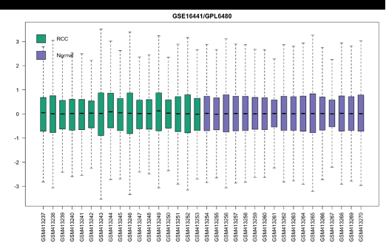
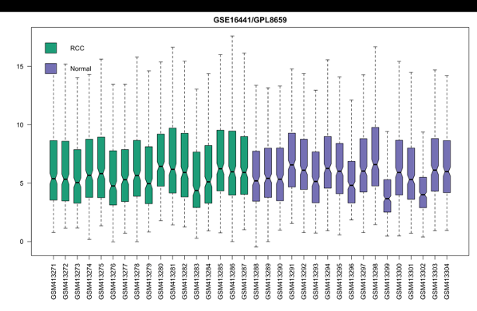
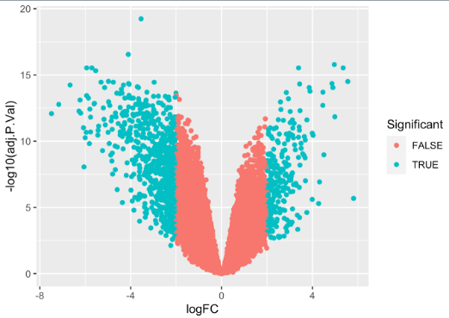
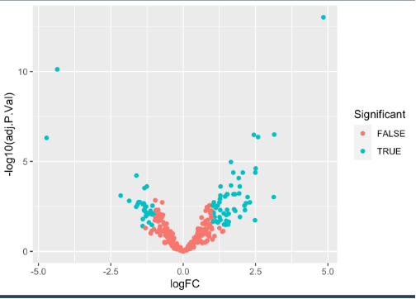

Slide 12
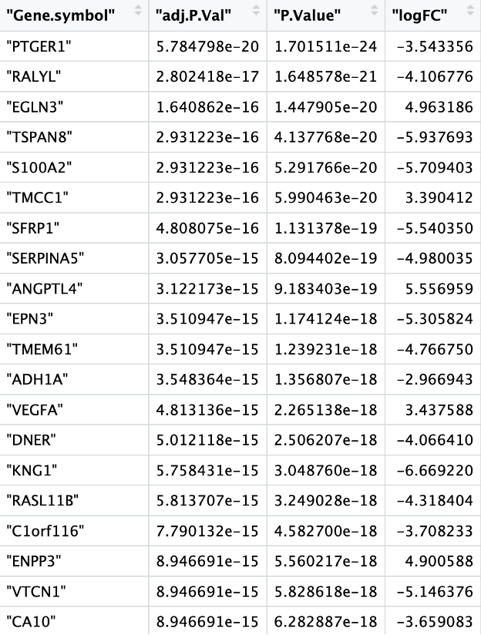
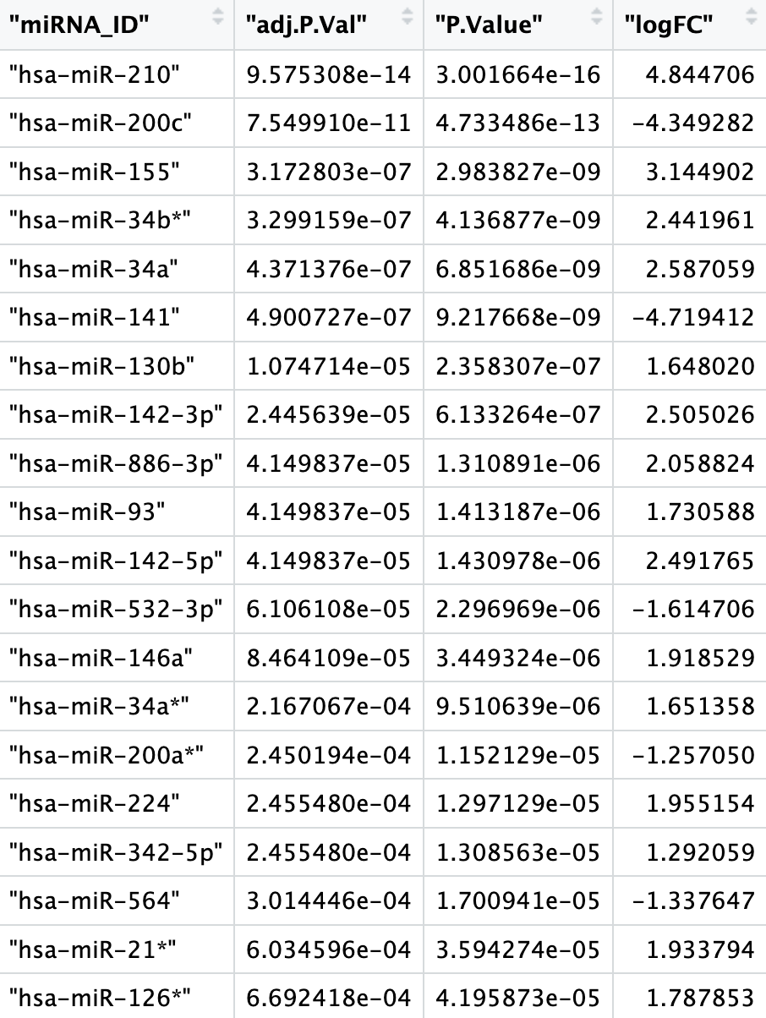
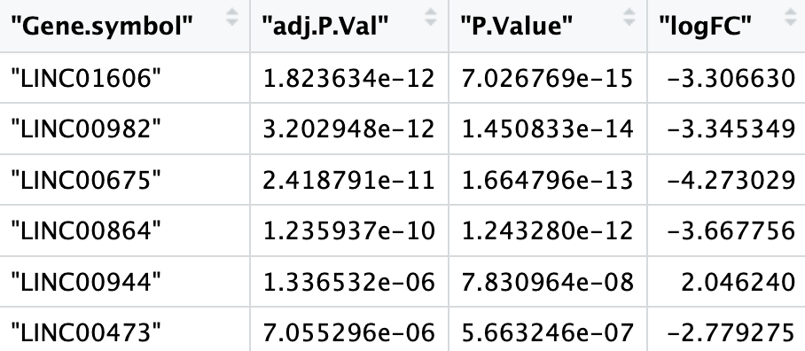

Slide 13
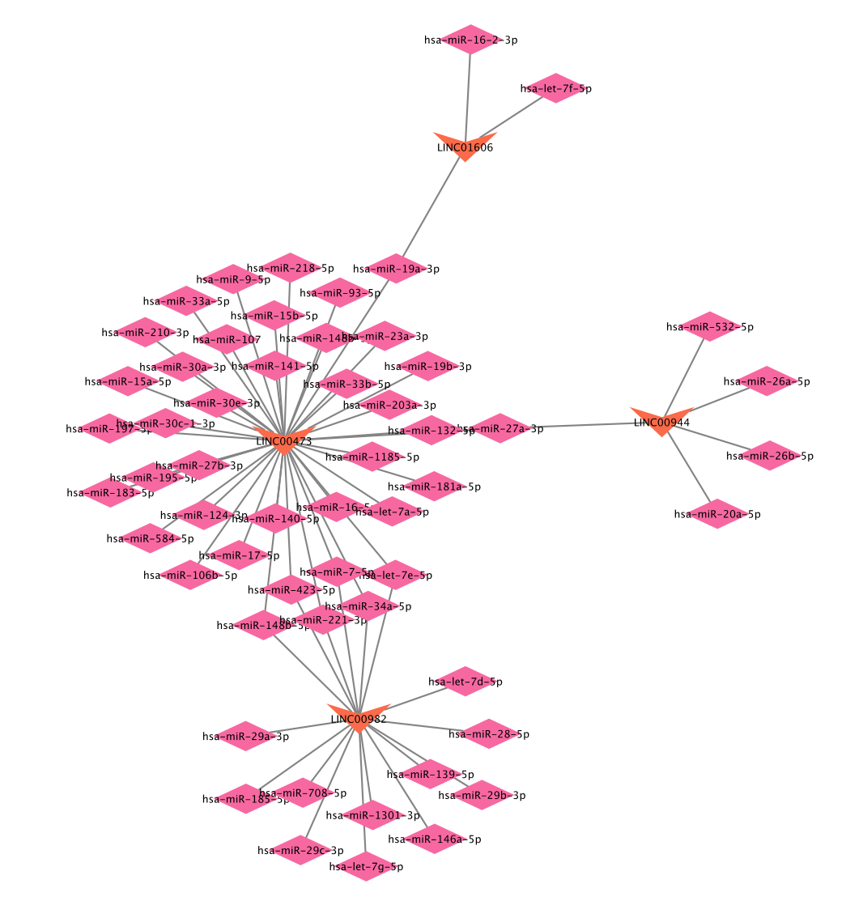
3 Results 3.2 Prediction of miRNA-mRNA and lncRNA-miRNA pairs & Establishment of the ceRNA network of lncRNA-miRNA-mRNA
From the six DELs, only four were found to interact with miRNAs by using the DIANA-LncBase database. These interactions which are a total 64 can be visualized in this figure.
However, 56 unique miRNAs were predicted (1 miRNA may interact with many lncRNA).
By taking the intersection of these 56 miRNAs with the DEMs already found before, we will find only three miRNAs interacting with three LncRNAs:
LINC00982 interacts with hsa-miR-28-5p; hsa-miR-532-5p LINC00944 interacts with hsa-miR-532-5p and LINC00473 interacts with hsa-miR-140-5p

Slide 14
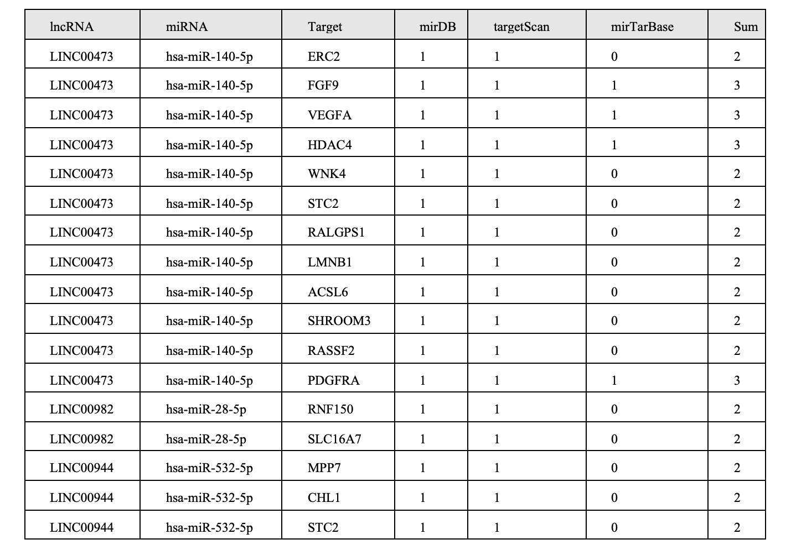
3 Results 3.2 Prediction of miRNA-mRNA and lncRNA-miRNA pairs & Establishment of the ceRNA network of lncRNA-miRNA-mRNA
.
By using the first approach of the three databases, I obtained this table which are the results of the 17 miRNA-mRNA interactions, coming from the 3 miRNAs found before.
These results were not used because the number was not sufficient.

Slide 15
3 Results 3.2 Prediction of miRNA-mRNA and lncRNA-miRNA pairs & Establishment of the ceRNA network of lncRNA-miRNA-mRNA
Another approach was used relying on the mirWalk database to identify miRNA-mRNA interactions
These three miRNAs were found to interact with 4,997 target mRNAs
Intersection of these predicted mRNAs with the 880 differentially expressed mRNAs identified 208 final DEmRNAs
267 miRNA-mRNA interactions were selected and combined with the lncRNA-miRNA interaction to construct the ceRNA network shown in Figure 4.

Slide 16
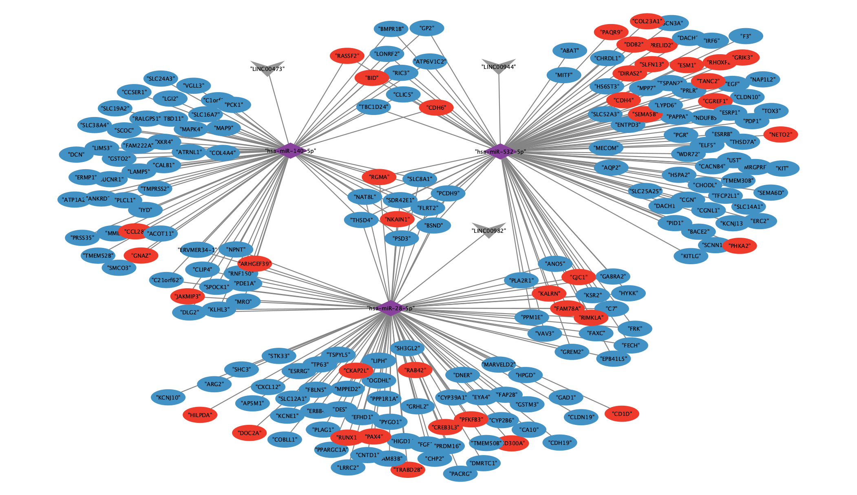

Slide 17
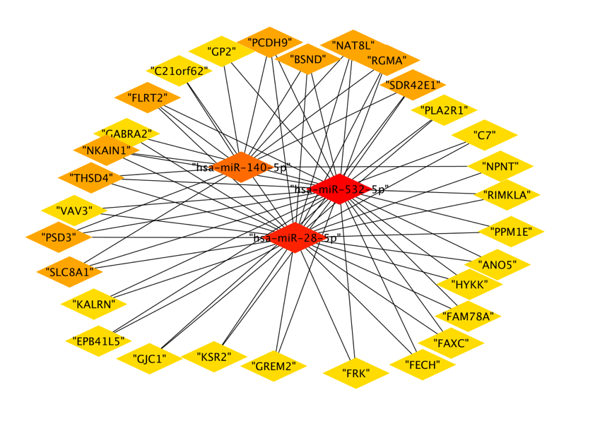
3 Results 3.3 PPI network analysis and key gene identification
The top 30 DEGs of ceRNA network based on degree of connectivity using cytoHubba were shown in this figure.

Slide 18
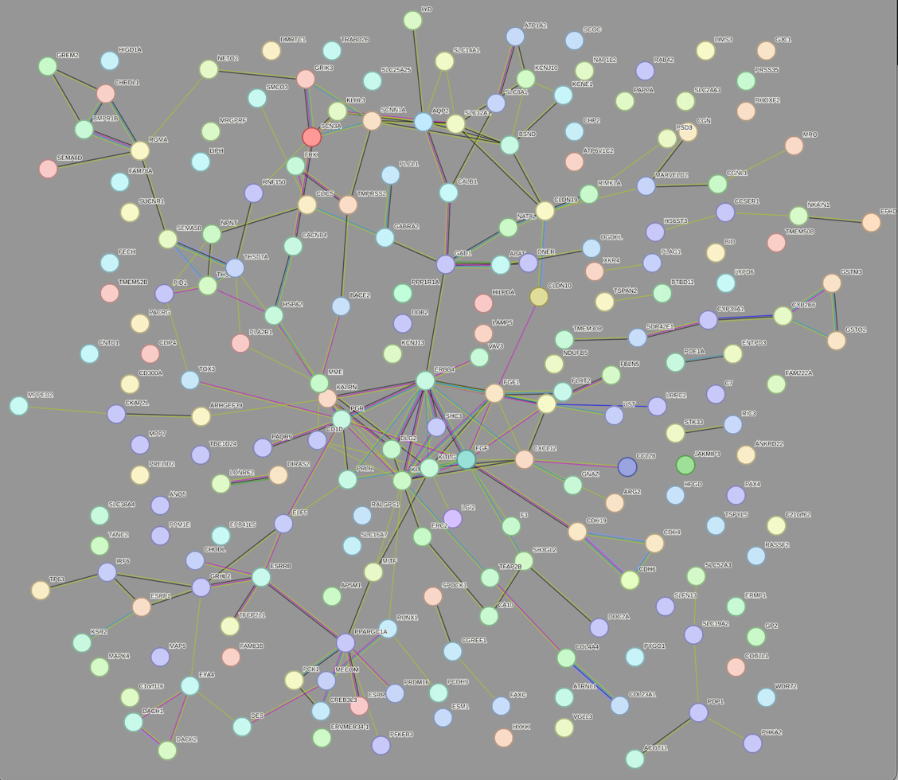
3 Results 3.3 PPI network analysis and key gene identification
Uploading these DEGs to STRING website, 188 edges and 208 nodes were found in the PPI network showed here.

Slide 19
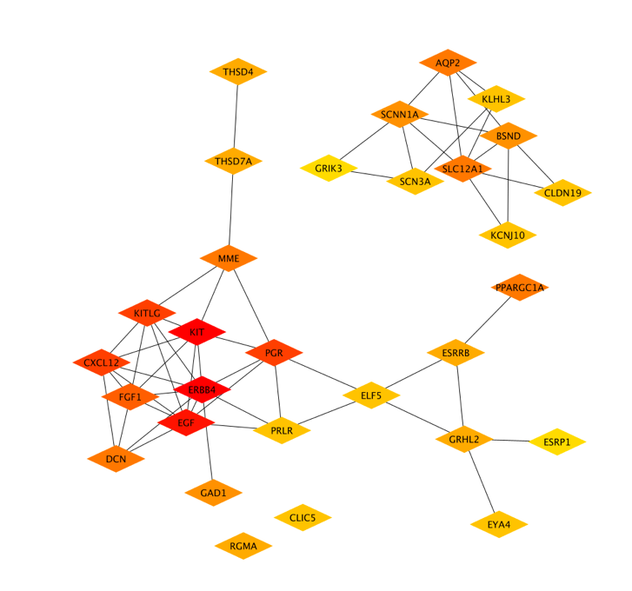
3 Results 3.3 PPI network analysis and key gene identification
The top 30 DEGs of PPI network identified by cytoHubba were visualized in this figure.

Slide 20
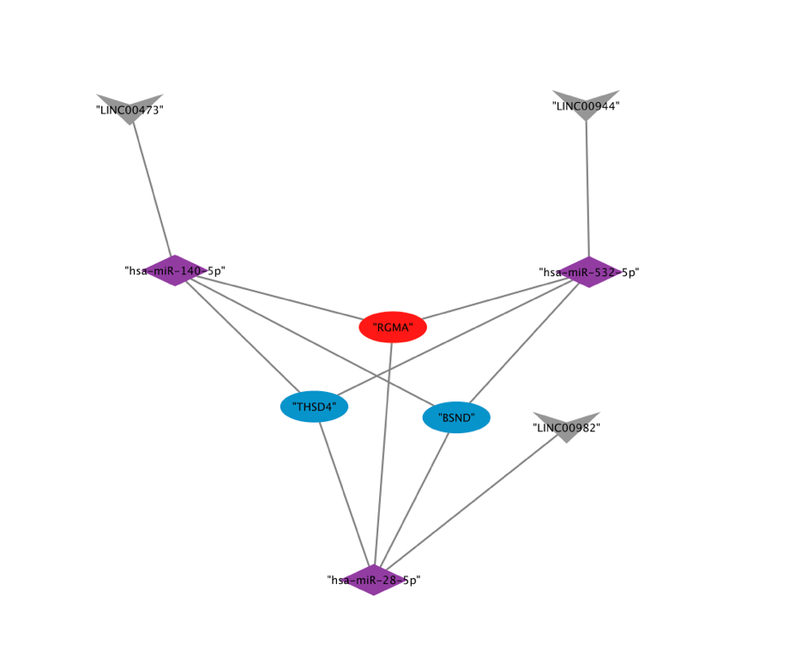
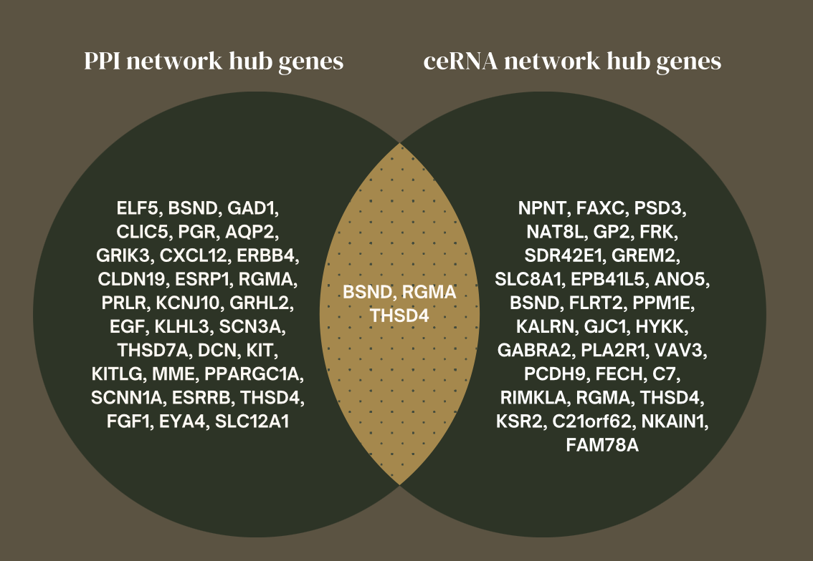
3 Results 3.3 PPI network analysis and key gene identification
Three key genes (BSND, RGMA, THSD4) were determined by Venn Diagram of ceRNA network and PPI network.
The key genes ceRNA sub network was visualized with Cytoscape.

Slide 21
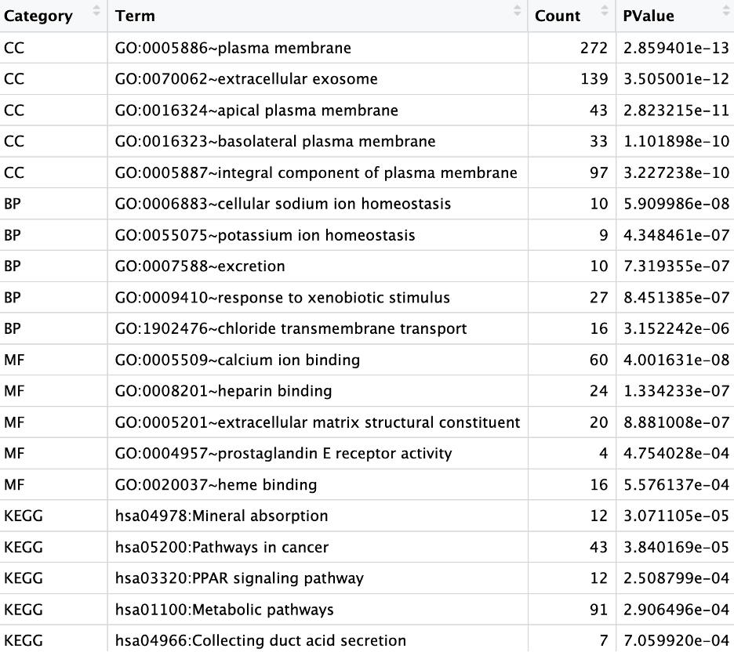
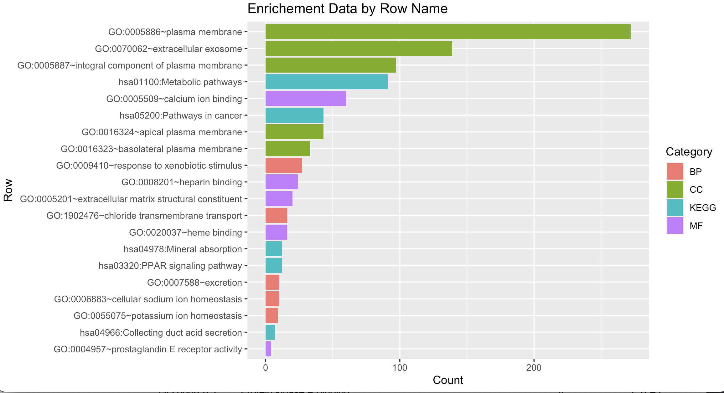
3 Results 3.4 Gene Ontology and Pathway Analysis
Two enrichment analyses were performed on differentially expressed genes (DEGs).
The first analysis was done on the 880 DEGs and significant results in GO terms and KEGG pathways related to kidney functions affected by Renal Cell Carcinoma were found.
43 genes were involved in pathways in cancer in the KEGG pathways.
Other genes were involved in the plasma membrane, ion homeostasis, excretion, etc… all functions of the kidney

Slide 22
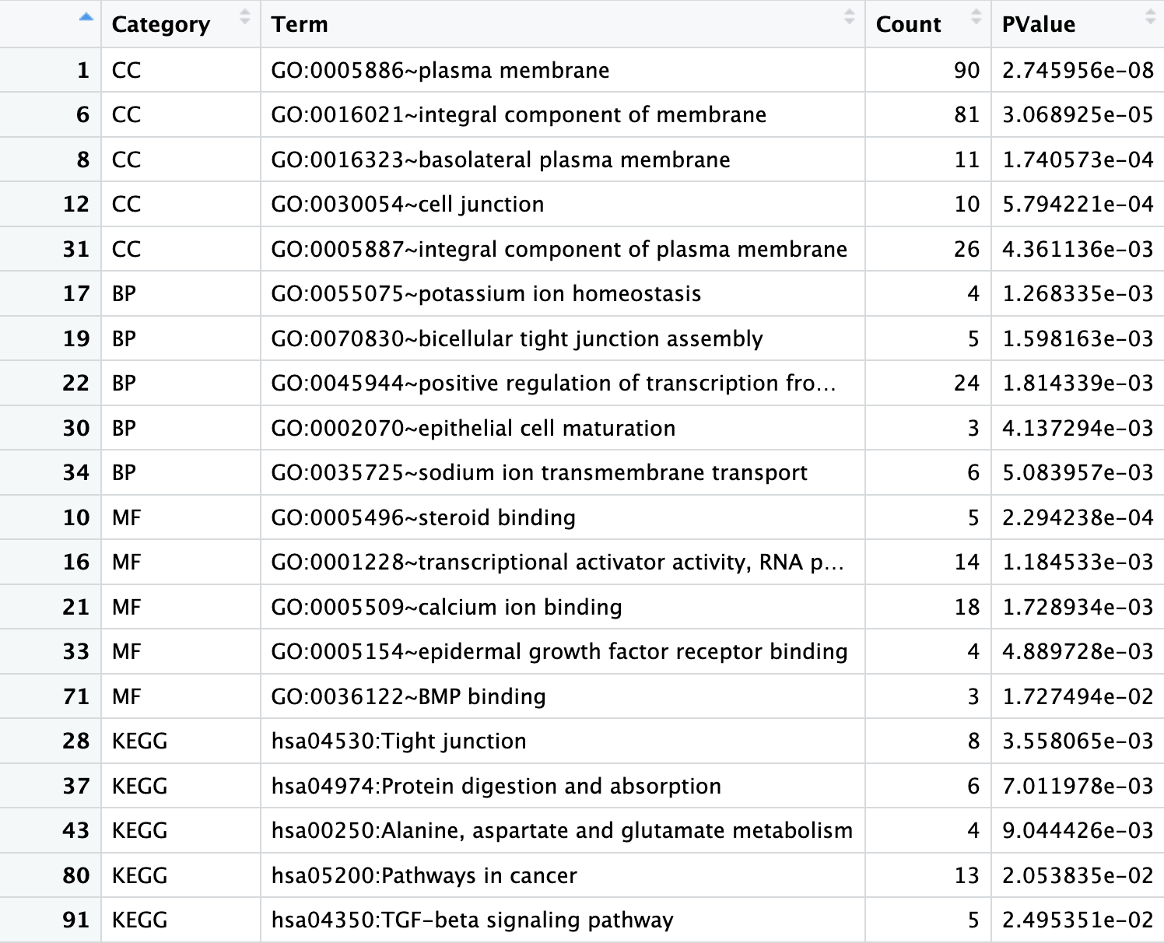
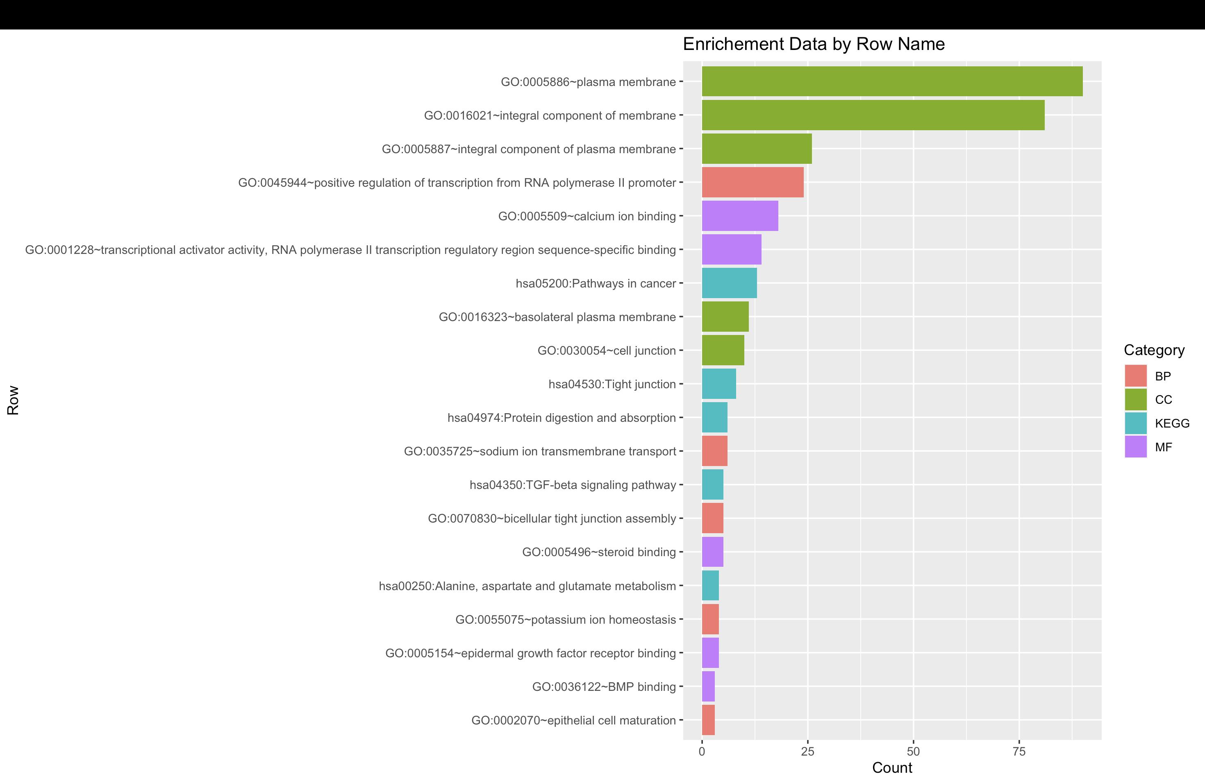
3 Results 3.4 Gene Ontology and Pathway Analysis
The second analysis was done on the 208 DEGs found in the PPI network, and results were associated with kidney functions affected by Renal Cell Carcinoma.
GO terms and KEGG pathways related to plasma membrane components, ions homeostasis and regulation, and pathways in cancer were found.

Slide 23
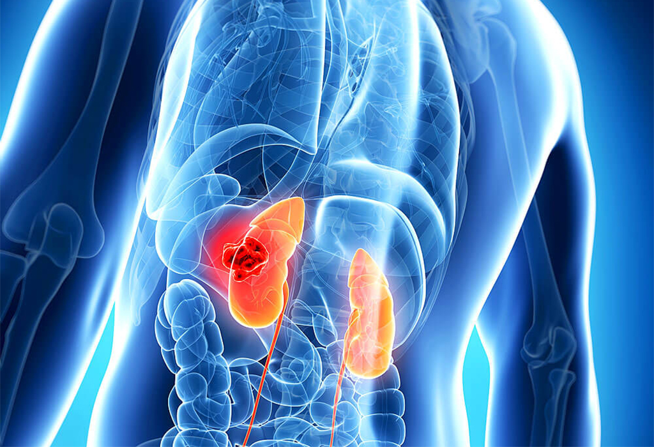
4 Discussion
Renal cell carcinoma (RCC) is a kidney cancer responsible for significant cancer-related deaths worldwide.
Dysregulation of various genes, including metabolic pathways, membrane transport, and apoptosis, contribute to RCC development and progression.
Long non-coding RNAs (lncRNAs) are emerging as important regulators of gene expression implicated in the pathogenesis of RCC.

Slide 24

4 Discussion
In this study I investigated the ceRNA network in RCC using bioinformatic analysis.
The study identified several lncRNAs, miRNAs, and mRNAs that interact in the RCC ceRNA network. A sub ceRNA network was also formed
including LINC00473 (down regulated), LINC00944 (up regulated), and LINC00982 (down regulated),
as well as miRNAs hsa-miR-140-5p (up regulated), hsa-miR-28-5p (up regulated), and hsa-miR-532-5p (down regulated)
which were found to interact with the genes RGMA (up regulated), BSND (down regulated), and THSD4 (down regulated).

Slide 25
4 Discussion
This study is consistent with previous research on the role of lncRNAs in cancer.
A study by (Chen & Zheng, 2021) provided clinical and experimental evidence that LINC00944 acts as an oncogene in RCC when up regulated.
According to (Li et al., 2021), downregulation of LINC00473 plays an important role in the development of multiple human cancers, such as lung cancer, gastric cancer, and colorectal cancer
LINC00982 has been found to regulate cell proliferation in various types of cancer, including gastric cancer (Fei et al., 2016), breast cancer (Chi et al., 2022), and RCC (Zhang et al., 2019).
These findings suggest that lncRNAs may be promising biomarkers and therapeutic targets for RCC.

Slide 26

4 Discussion
The miRNAs obtained were found to be dysregulated and involved in many types of cancers, including RCC (Renal Cell Carcinoma) and others.
miR-140-5p up regulation was involved in the case of lung cancer invasion and tumor progression (Flamini et al, 2017).
miR-28-5p upregulation promoted the progression of ovarian cancer cell cycle, proliferation, migration, and invasion (Xu et al, 2017).
miR-532-5p was heavily downregulated and found to inhibit RCC cell proliferation when overexpressed, while knockdown of miR-532-5p promoted cell proliferation (Zhai et al, 2018).
These findings suggest the potential of these miRNAs as therapeutic targets for cancer treatment.

Slide 27
4 Discussion
Considering the genes, The RGMA gene, also known as RGM domain family member A, is a gene that encodes the Repulsive Guidance Molecule A (RGMA) protein.
RGMA is a protein that is involved in the regulation of neuronal growth and guidance during embryonic development. In addition to its role in neuronal development, RGMA has also been implicated in the regulation of angiogenesis, which is the formation of new blood vessels from pre-existing ones.
RGMA has been identified as a potential oncogene in various types of cancer. Regarding its association with cancer, some studies have suggested that RGMA upregulation may have pro tumorigenic effects, like in the case of colorectal cancer (Chan et al, 2008), and promote tumor cell migration and invasion.
In the context of renal cell carcinoma, the upregulation of RGMA could suggest a potential role for this protein in promoting tumor growth and metastasis.

Slide 28
4 Discussion
The BSND gene is involved in the normal function of chloride channels in the kidneys and inner ear.
Downregulation of BSND leads to a dysfunctional or absent barttin protein, resulting in salt wasting, renal tubular defects, and hearing loss.
There is currently no strong evidence linking BSND downregulation to the development or progression of RCC or other types of cancer.
However, alterations in the expression of genes involved in ion transport and regulation can contribute to dysregulation of cellular processes and potentially affect tumor development and progression.

Slide 29
4 Discussion
THSD4, also known as Thrombospondin Type-1 Domain-Containing Protein 4, is a protein that is involved in various biological processes, including angiogenesis, cell adhesion, and extracellular matrix organization.
(Tan et al, 2022) showed that the expression levels of THSD4 were downregulated in bladder cancer tissues compared with normal tissues.

Slide 30

4 Discussion
These findings are based on bioinformatic analysis, and further experimental validation is required to confirm the interactions between these RNAs and genes in RCC.
Nonetheless, the results provide a valuable starting point for further investigation into the mechanisms underlying RCC pathogenesis and the development of new therapeutic strategies for this disease.

Slide 31

Conclusion
In conclusion, this work successfully constructed a ceRNA network by bioinformatics analysis based on the GEO database, providing a comprehensive resource for investigating the ceRNA regulation in RCC.
Overall, the results suggest that the dysregulation of lncRNAs and miRNAs may play an important role in the development and progression of RCC by regulating the expression of target genes.

Slide 32
Conclusion
Importantly, candidate prognostic biomarkers that are involved in the ceRNA network were screened (a sub-ceRNA network was created), involving 3 lncRNA (LINC00473, LINC00944, LINC00982), 3 miRNA (hsa-miR-140-5p, hsa-miR-28-5p, hsa-miR-532-5p) and 3 key/hub genes (RGMA, THSD4 and BSND) which may exhibit important roles in the therapeutic target and prognosis analysis in RCC patients.

